Slide 1

Diabetes Prediction using Logistic Regression
Name : V Ganesh
Roll no : B18CS062
Branch : CSE
Section : CSE-II
Year : 2020-2021
Counsellor : K. Johnson

Slide 2
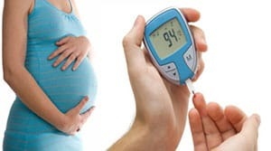
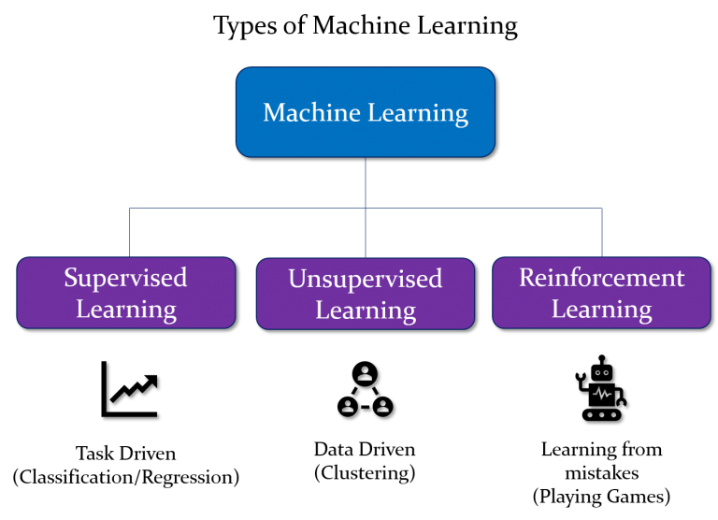

INTRODUCTION
What is diabetes?
Why are we using machine learning?
Supervised vs Unsupervised

Slide 3
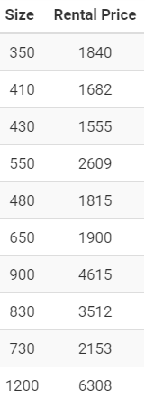
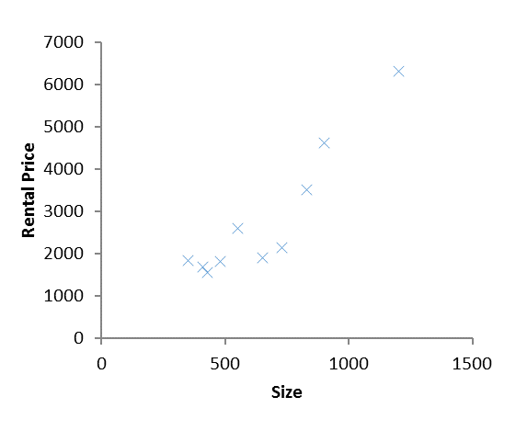
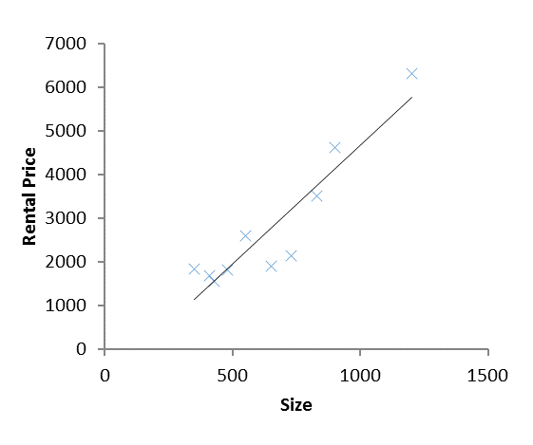
Linear Regression
Regression analysis is a form of predictive modelling technique which investigates the relationship between a dependent and independent variable .

Slide 4
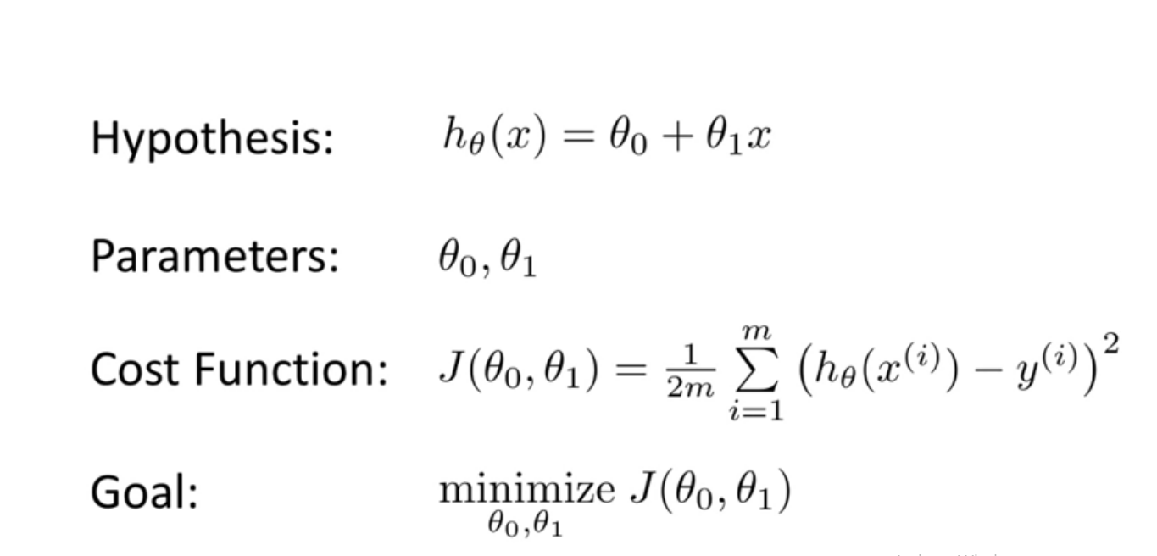
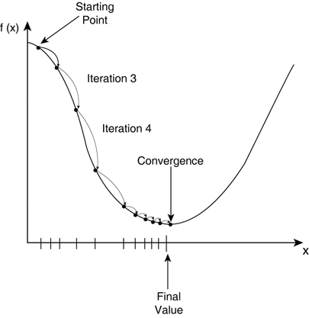
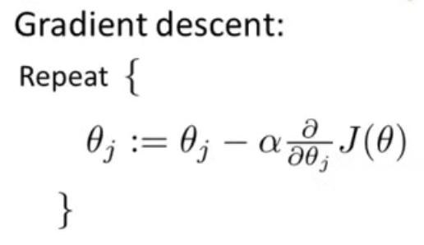

Slide 5
OBJECTIVES
Early prediction of diabetes for a patient.
Helps doctors and practitioners.
To develop an user interface.

Slide 6
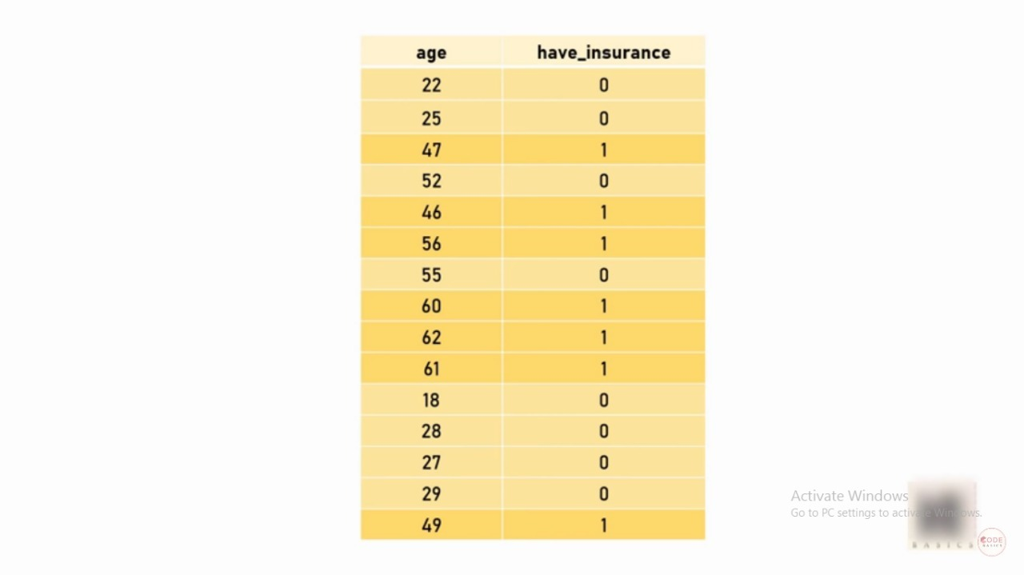
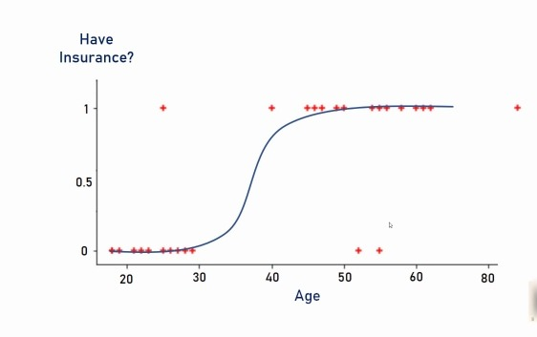
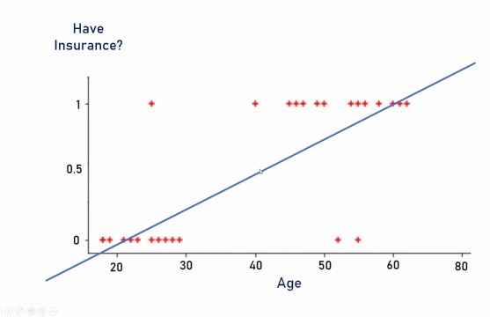
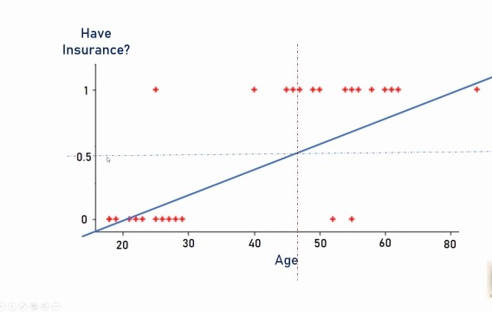
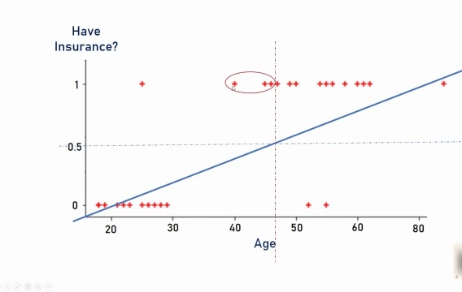
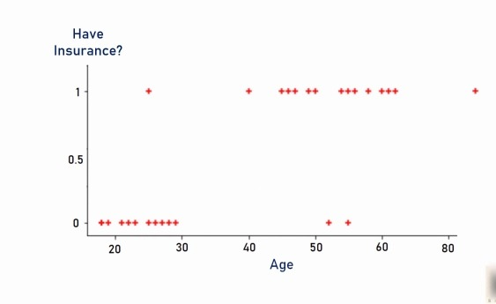
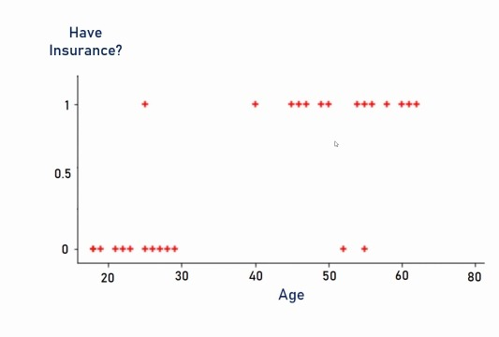
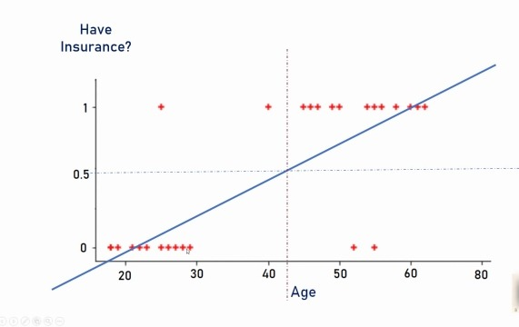
Methodology

Slide 7
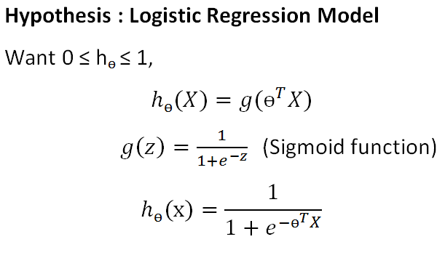
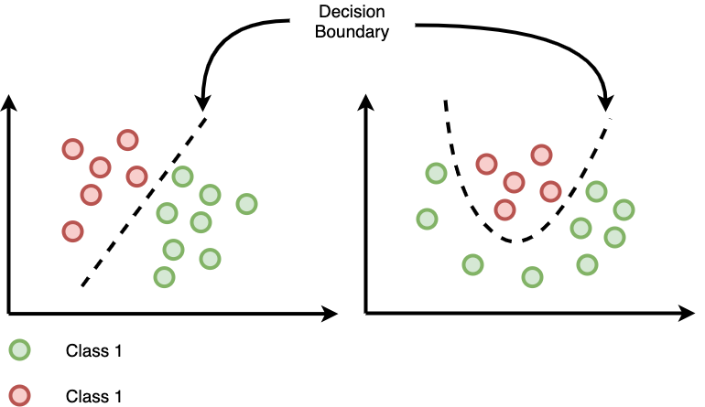
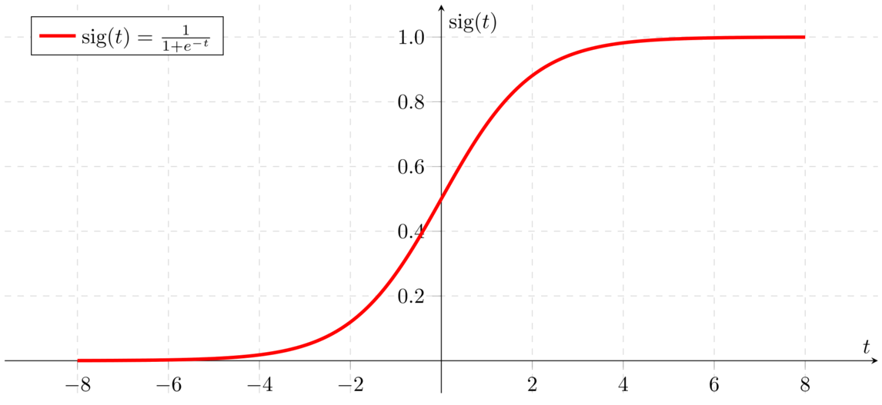
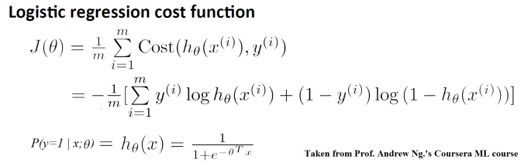
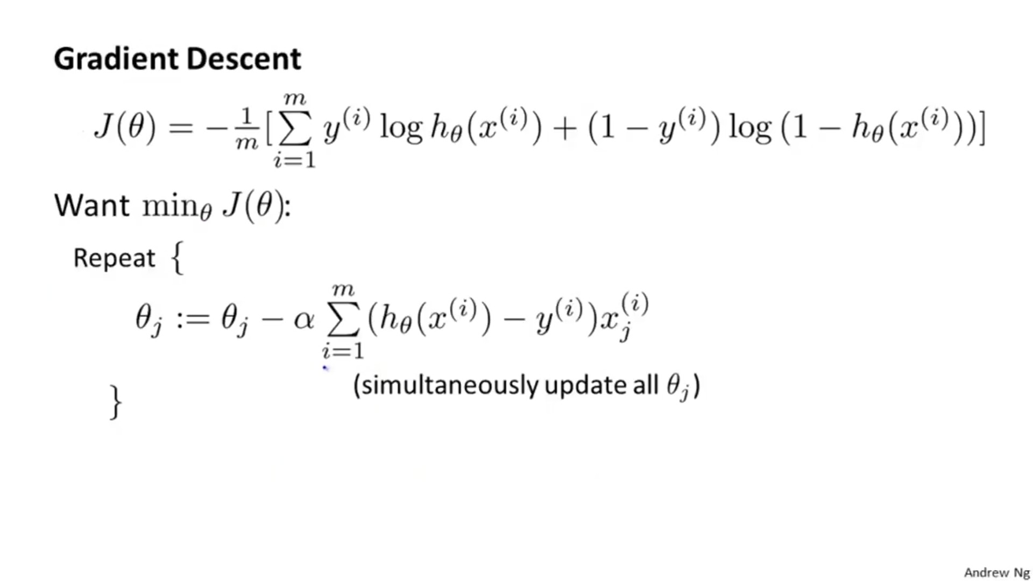

Slide 8
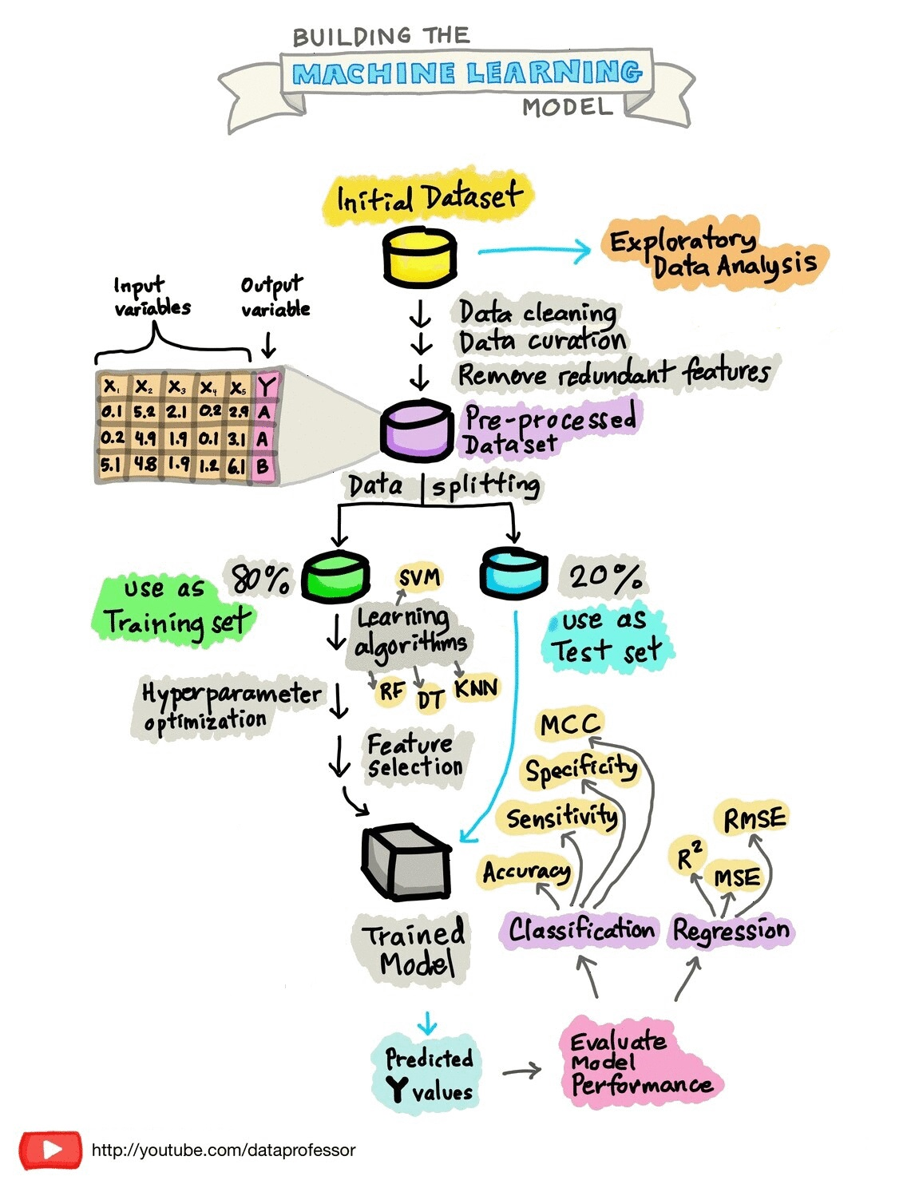
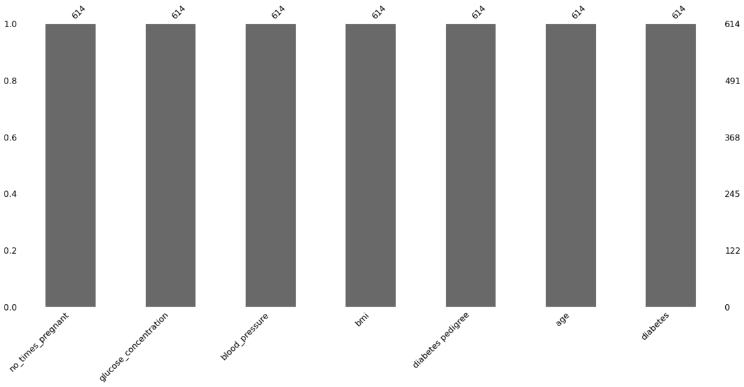
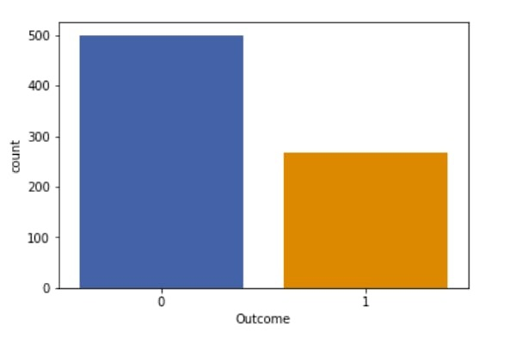
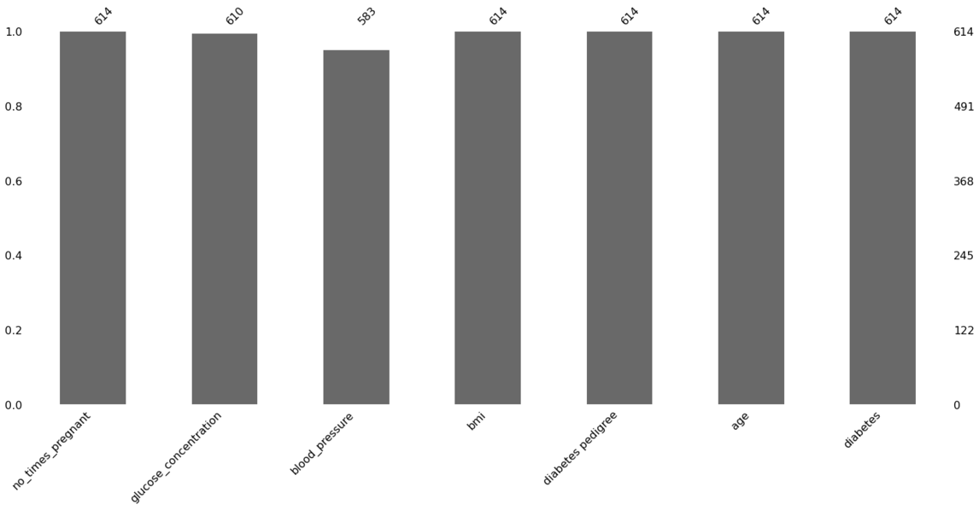
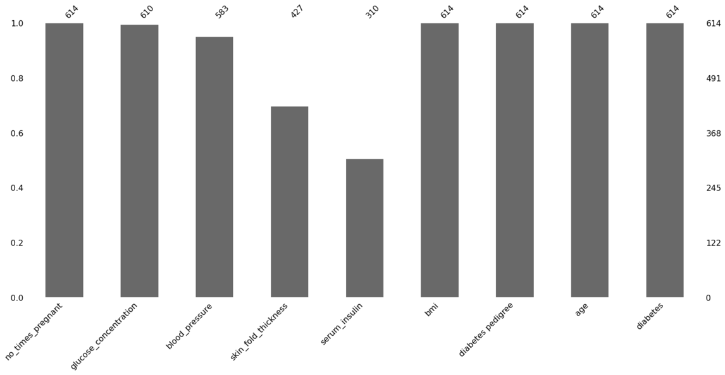
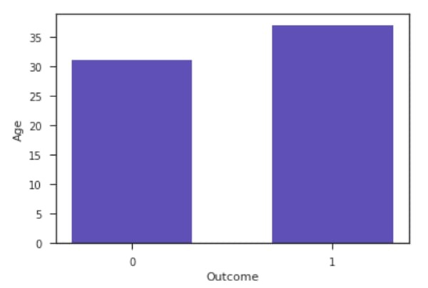
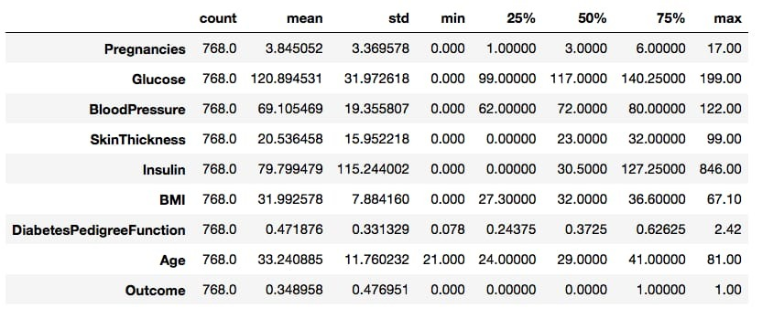
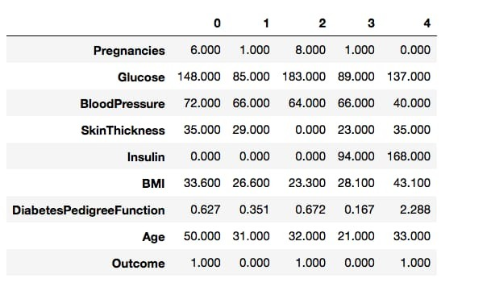

Slide 9
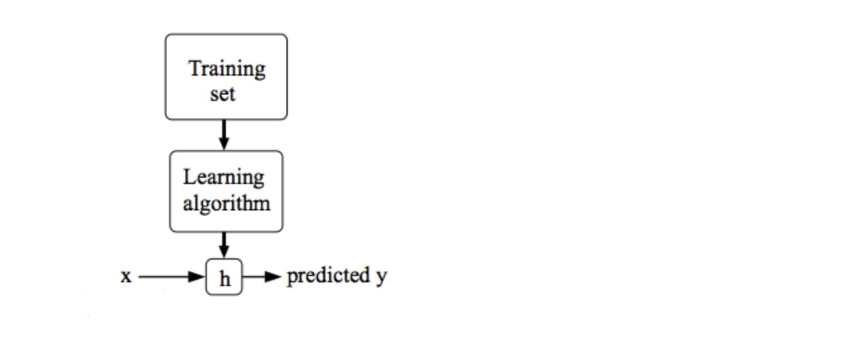
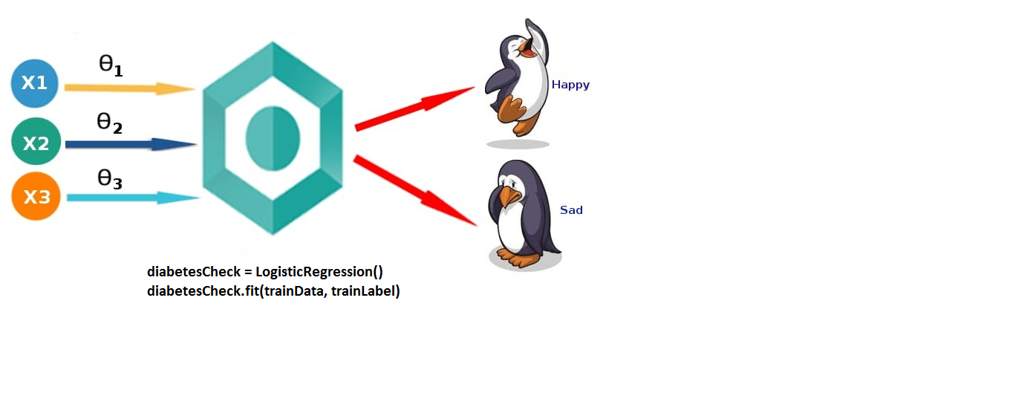
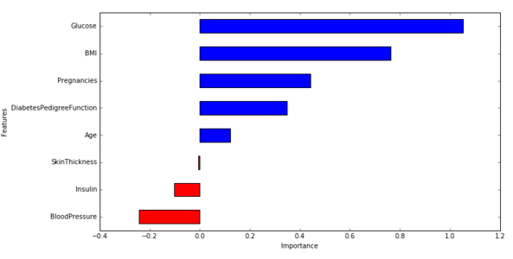
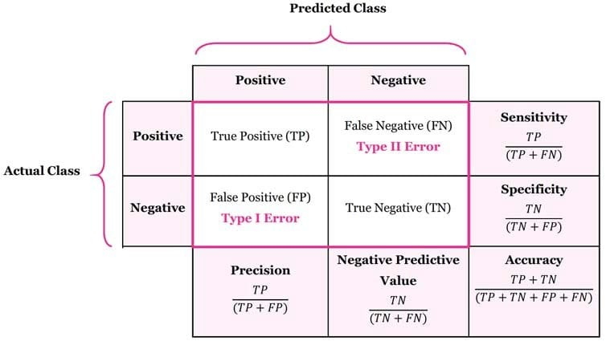
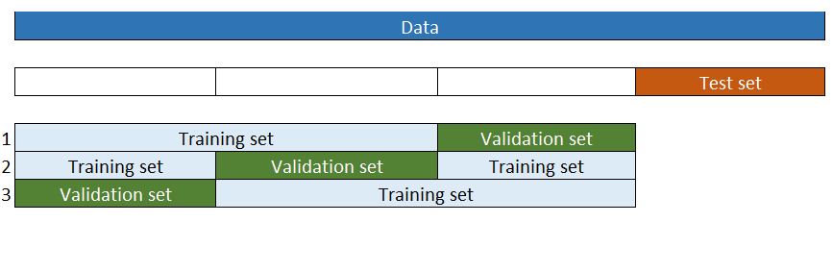

Slide 10
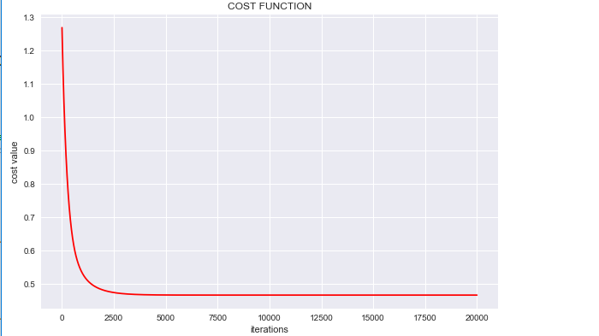
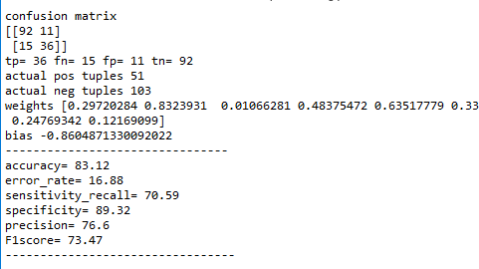
Project Execution

Slide 11

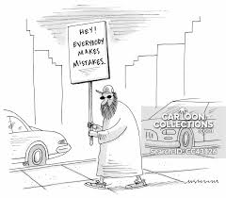
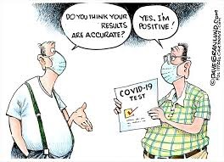
ADVANTAGES
Less time consumption
Economical
Simple
DISADVANTAGES
Overfitting
Wrong prediction
Complex Relationship

Slide 12
In this we have used machine learning algorithm to predict diabetes. The results could assist health care to take early prevention and make clinical decisions to control disease and thus save human life.
Conclusion

Slide 13
References
Daghistani and Riyad(2020),"Comparison of Logistic Regression and RandomForest ML Techniques in Predicting Diabetes", Journal of Advances in Information Technology Vol. 11, No.2.
Bhavya and Sanjay(2020), "Diabetes Prediction using Machine Learning", International Journal of Advanced Research in Computer and Communication Engineering, Vol. 9.
https://towardsdatascience.com/end-to-end-data-science-example-predicting-diabetes-with-logistic-regression-db9bc88b4d16
https://towardsdatascience.com/machine-learning-fundamentals-via-linear-regression-41a5d11f5220

Slide 14

Thank you!!!

